Slide 2
Stitching Satellite Imagies
Submitted to:
Department of Computer Science and Engineering

Slide 3
Supervised by:
. Prof.Priyanka Jangde
&
Prof. Narendra Pal
Team Members
1. Aayushi Jain
2. Alokit Sharma
3. Aman Solanki

Slide 4
Objective
Stitching together satellite images from adjacent passes.
To develop a fully automated algorithm to automatically stitch adjacent (multiple ) satellite images without human intervention to create a seamless mosaic. The algorithm needs to be fast enough for on-the-fly stitching for web based visualization.

Slide 5
Goals to Achieve
Our mission is to introduce Seamless Satellite-image Synthesis (SSS), a novel neural architecture to create scale-and-space continuous satellite textures from cartographic data.
To overcome tile size limitations in image-to-image translation approaches, SSS learns to remove seams between tiled images in a semantically meaningful manner. Scale-space continuity is achieved by a hierarchy of networks conditioned on style and cartographic data.
Our qualitative and quantitative evaluations show that our system improves over the state-of-the-art in several key areas. We show applications to texturing procedurally generated maps and interactive satellite image manipulation.

Slide 6
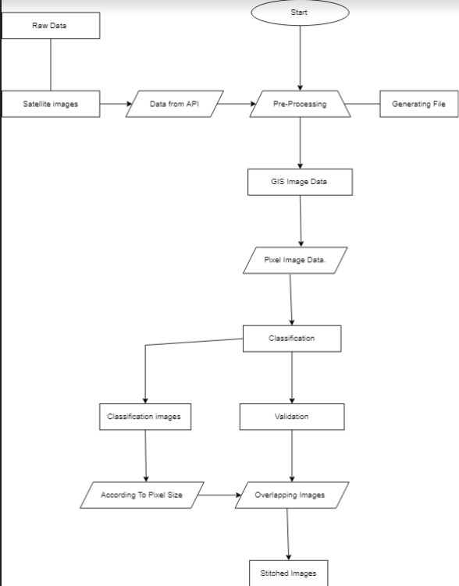
Flow Chart

Slide 7
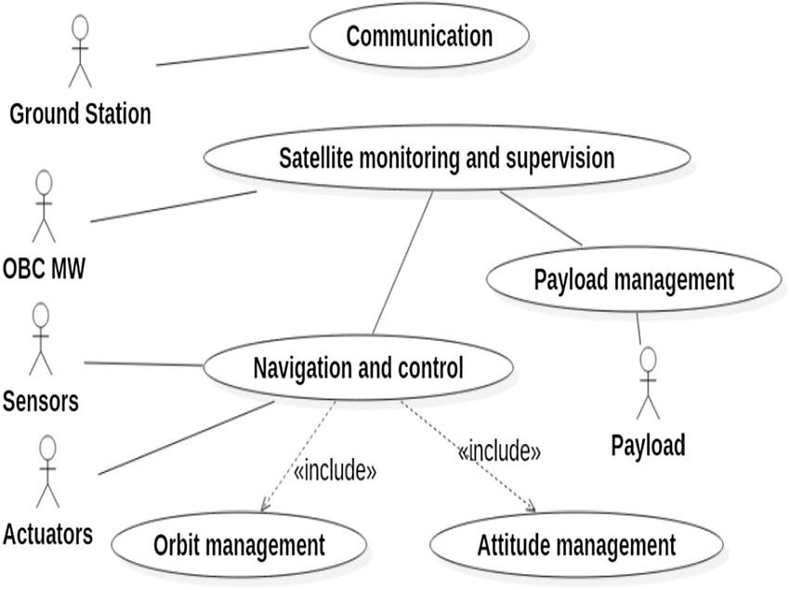
U M L

Slide 8
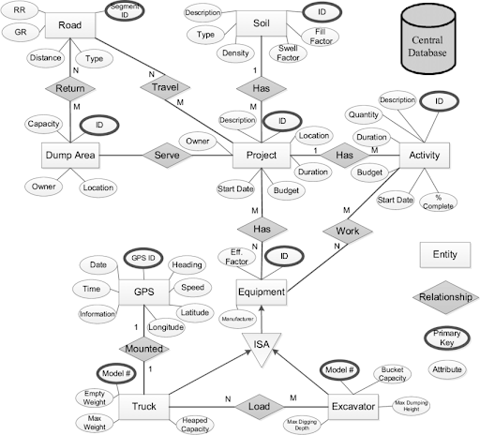
ER Diagram

Slide 9
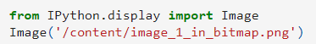
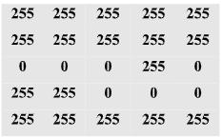
Pre-Processing
Converting images to bitmap and string format
Images are represented in computer in the form of an 8-bit matrix where each matrix element, known as a pixel has values ranging from 0 to 255 representing the different pixel intensities. With the help of a threshold function images can be converted to bitmaps where each pixel can only have two values, 0 or 255. All pixel intensities below the decided threshold value are deemed 0 and those above the threshold are deemed 255. This basically convert the image to binary format, where black pixels are assigned ‘0’ and white pixels are assigned ‘255’.
image1 in a bitmap:
Notes:
Threshold: It is a function which convert bitmap.

Slide 10
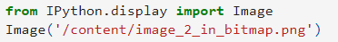
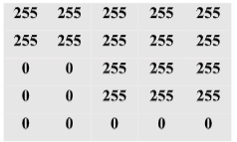
image2 in a bitmap:
Since Mapper function accepts input stored in files, the bitmap images are required to be converted to String format, to supply input as text. String format of images are defined as each pixel column separated by a comma ’,’ character and each pixel row is separated by a semicolon ‘;’ character.
String format representation of image1:
“255,255,255,255,255;255,255,255,255,255;0,0,0,255,0;255,255,0,0,0;255,255,255,255,255"
String format representation of image2:
“255,255,255,255,255;255,255,255,255,255;0,0,255,255,255;0,0,255,255,255;0,0,0,0,0”

Slide 11
Mapper
Creating new spaces for images
The images are defined in a new space, so that all possible matching cases between the two images can be calculated. This is the first mapper function.
Input: Image1_Str Image2_Str
Output: Image1_Str Image2_New_Space
For each image pair, the width and height of image1 is added around of the image2 as white pixels. Since image1 and image2 are 5X5 size images, thus the width of image1 (5 pixels) and height of image1 (5 pixels) is added to the width and height around image2, resulting in Image2_New_Space has a 13x13 size.

Slide 12
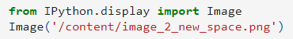
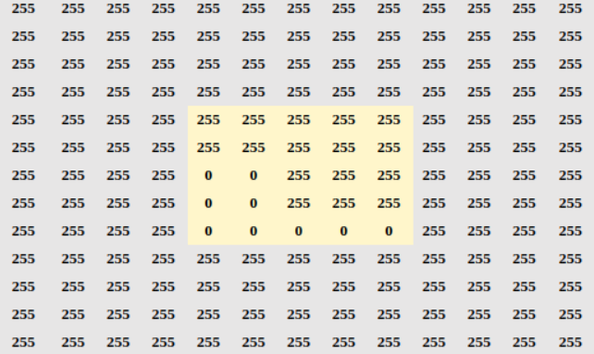
Image2_New_Space in a bitmap:

Slide 13
Reduce
Calculation of maximum number of black pixel overlaps between the images and the largest intersection coordinate for combining the images
The Image2_New_Space is defined such that it can test for all possible combinations of image1 and image2. The image1 matrix is thus traversed over the image2 matrix and the overlapping black pixels are counted. The elements of image1 are considered as a floating frame on image2(in new space). Black pixels in common indices are counted where one-to-one matching occurs between the first image and the second image.

Slide 14
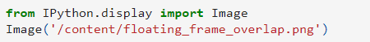
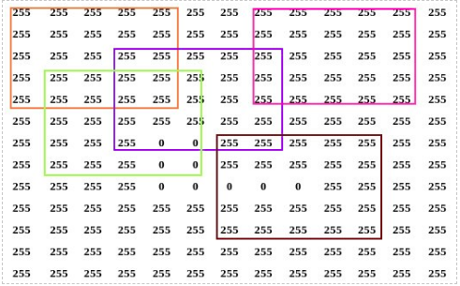
As shown in the above figure, the elements of the image1 matrix are matched with 5X5 matrices each marked with a different color in the second image matrix. This operation is performed for all 5X5 matrices defined in the Image2_New_Space matrix and common black pixels are counted for each pairing state.
The output of the reduce function gives us the maximum number of black pixel overlaps. The maximum number of lack pixel overlaps are found to be 3. Using this information, the largest intersection coordinate is obtained. For the Image2_New_Space, the largest intersection coordinate with respect to image1 is calculated as (6,6)

Slide 15
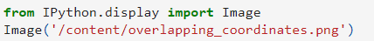
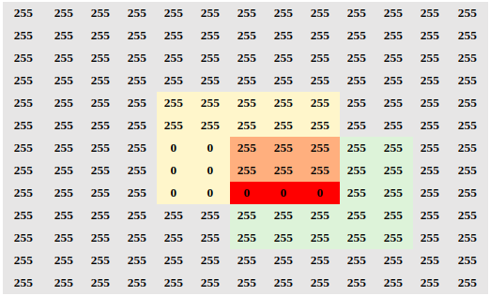

Slide 16
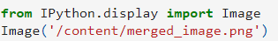
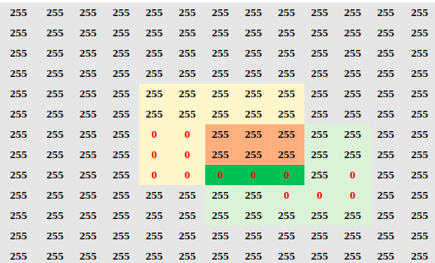
Merge
Using the obtained coordinate from the reduce functions, a merge operation is used to obtain the stitched image. The size of the merged image is defined as (3a-2) x (3b-2), where the size of the images is (a x b).

Slide 17
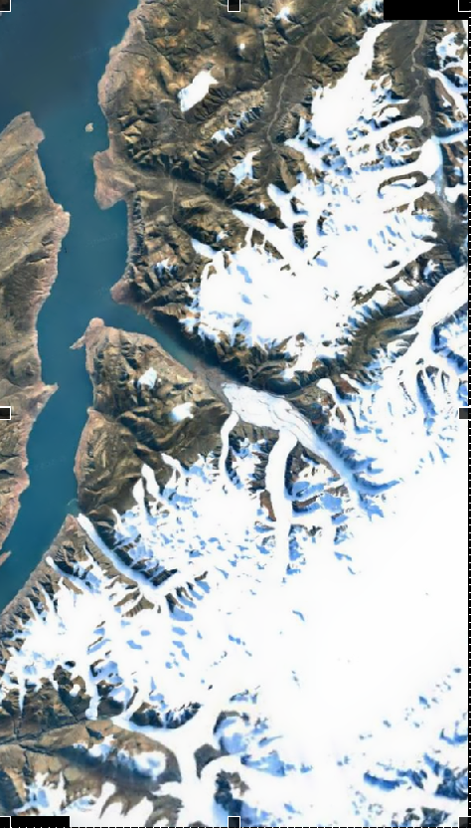
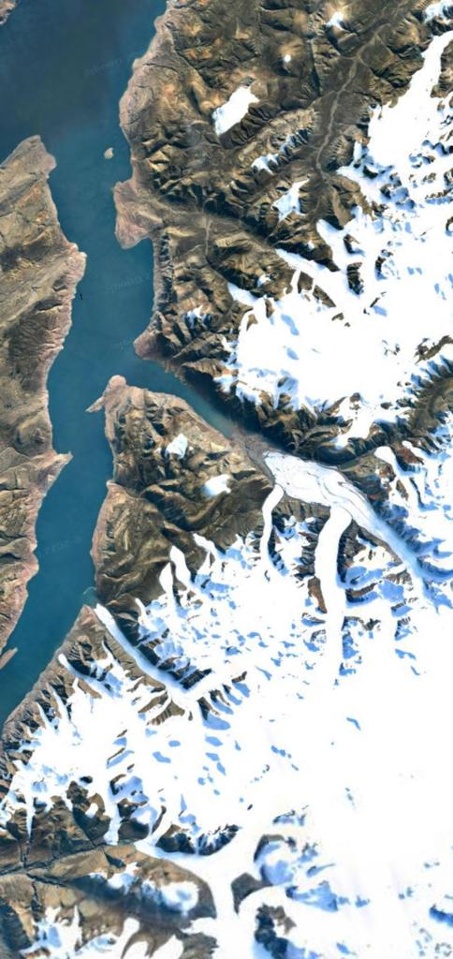
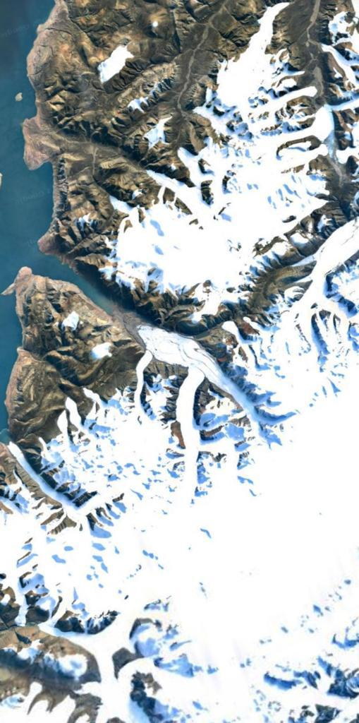
Demo

Slide 18
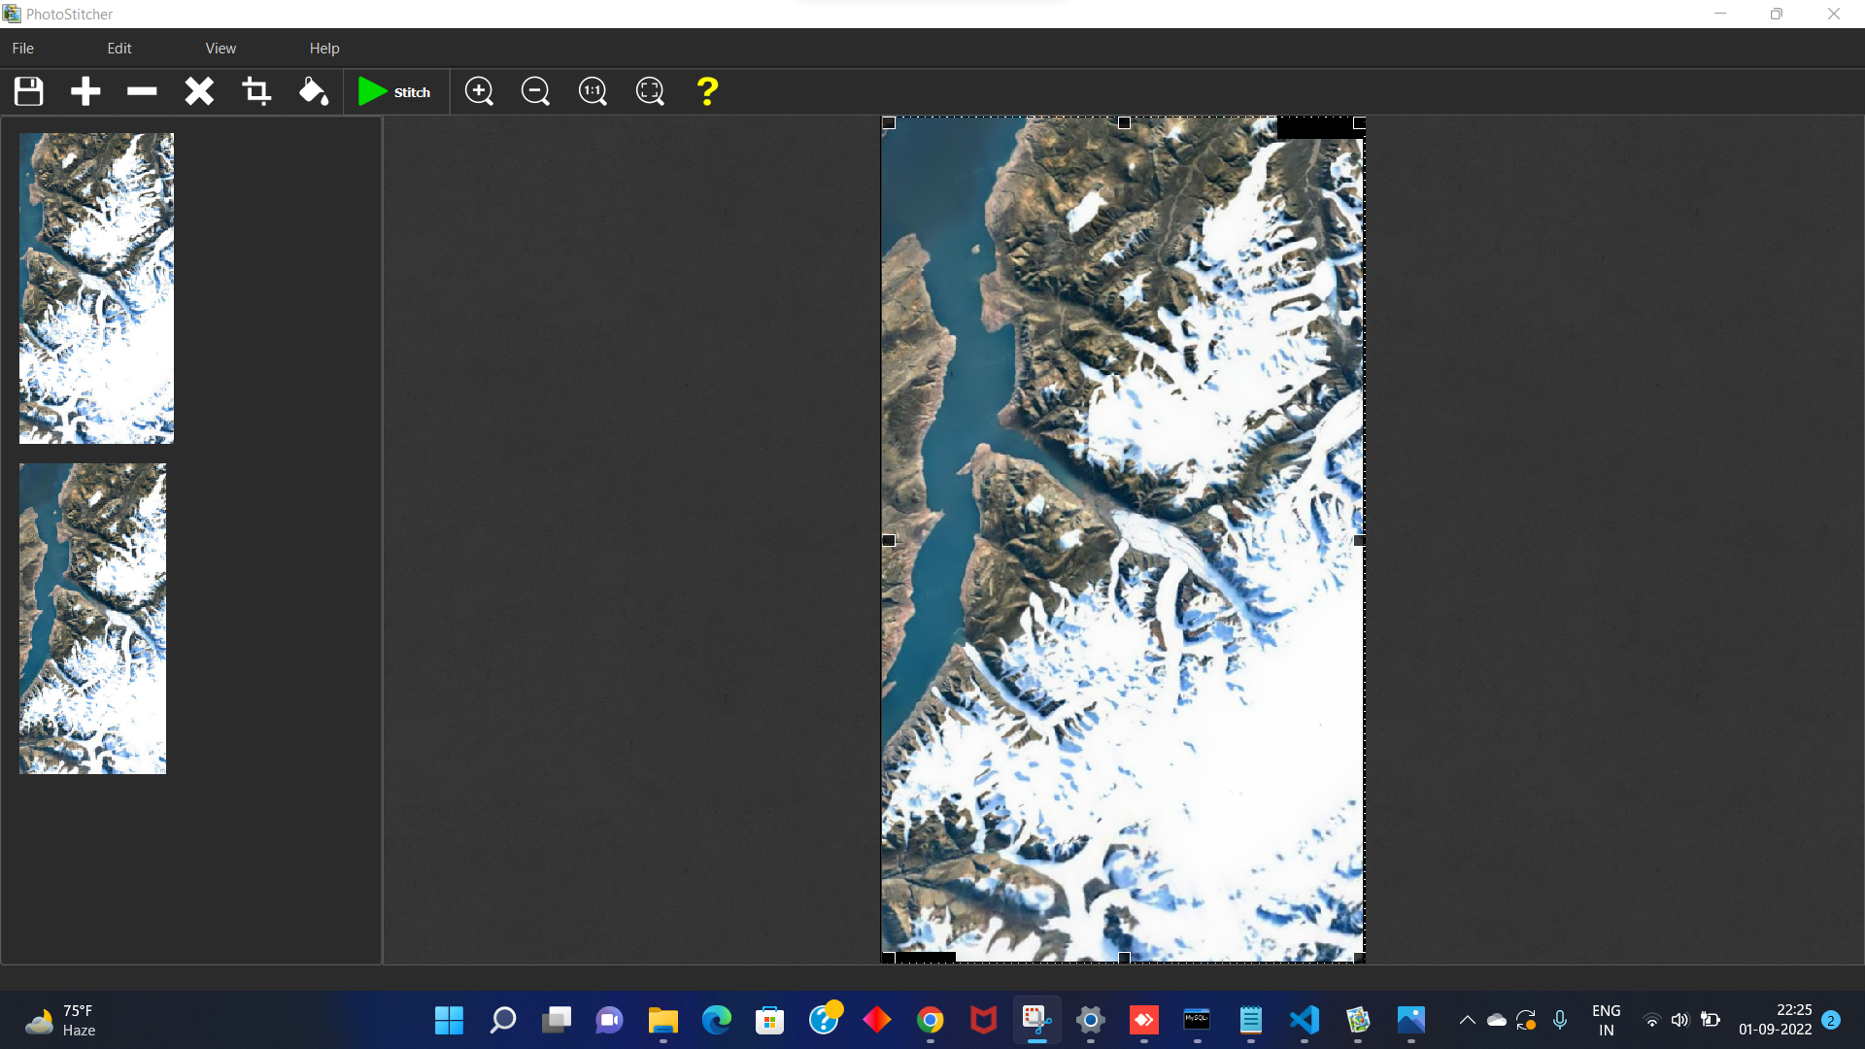
Demo Application
-Photostitcher

Slide 19
Uses
Works with any arrangement of overlapping photos taken from a single location.
Accelerated stitching on multiple CPU cores.
Automatic cropping to maximum image area.
Automatic exposure blending.
Automatically stitch scanned images into a large picture.

Slide 20
Boi Boi

